Slide 1


Test Automation Using Selenium
Fair Hike Academy
That’s the way the cookie crumbles!
Session 17: TestNG Annotations and XML driven Test Execution
Mentor : Naresh Vulli, CSTE, PAHM.
fairhike@gmail.com www.fairhike.blogspot.com | www.facebook.com/fairhike

Slide 2
Today’s Topics
Recap
TestNG Annotations
Understand XML
Create a Suite of tests
Run XML thru cmd
Batch file Execution
Scheduling of Tests
Takeaways or Exercise

Slide 3
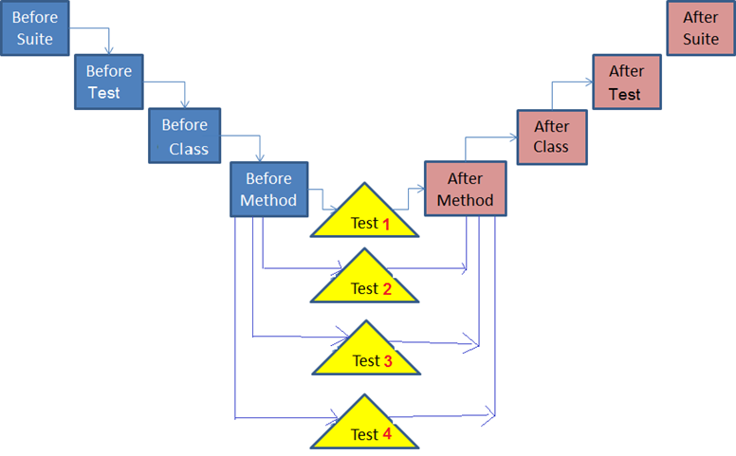
TestNG Annotations
http://testng.org/doc/documentation-main.html#annotations

Slide 4
Understanding XML
<?xml version="1.0" encoding="UTF-8"?>
<!DOCTYPE suite SYSTEM "http://testng.org/testng-1.0.dtd">
<suite name="Suite1">
<test name=“Test2">
<classes>
<class name=“pkg.class2">
<methods>
<include name="testMethod1" />
<include name="testMethod2" />
</methods>
</class>
</classes>
</test>
</suite>

Slide 5
Create a Suite of tests
<?xml version="1.0" encoding="UTF-8"?>
<!DOCTYPE suite SYSTEM "http://testng.org/testng-1.0.dtd">
<suite name="Suite1">
<test name=“Test1">
<classes>
<class name=“pkg.class1">
</class>
</classes>
</test>
<test name=“Test2">
<classes>
<class name=“pkg.class2">
</class>
</classes>
</test>
</suite>

Slide 6
Run XML thru CMD
Launch CMD Prompt, Navigate to the folder path of your TestNG Project using CD command
CD C:\Users\Welcome\workspace\SelinumTestProject
set ProjectPath=C:\Users\Welcome\workspace\SelinumTestProject
set classpath=%ProjectPath%\bin;%ProjectPath%\lib\*;%ProjectPath%\lib\poi\*;%ProjectPath%\lib\selenium-2.53.0\*;%ProjectPath%\lib\selenium-2.53.0\libs\*;
set path=C:\Program Files (x86)\Java\jre1.8.0_65\bin;
Run XML using -
java org.testng.TestNG %ProjectPath%\testng.xml

Slide 7
Run Test using batch file
@echo off
:: If script failing then update below line as per your environment
set ProjectPath=C:\Users\Welcome\workspace\SelinumTestProject
echo %ProjectPath%
set classpath=%ProjectPath%\bin;%ProjectPath%\lib\*;%ProjectPath%\lib\poi\*;%ProjectPath%\lib\selenium-2.53.0\*;%ProjectPath%\lib\selenium-2.53.0\libs\*;
echo %classpath%
set path=C:\Program Files (x86)\Java\jre1.8.0_65\bin;
echo %path%
java org.testng.TestNG %ProjectPath%\testng.xml

Slide 8
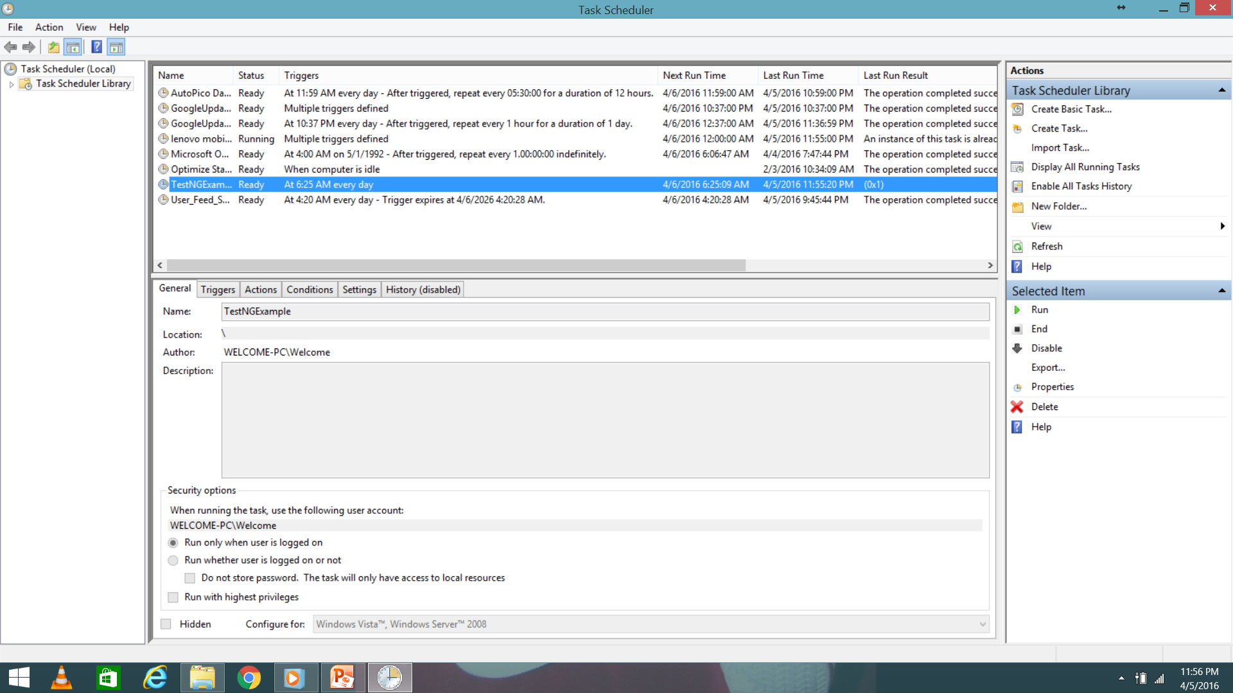
Scheduling Tests
Windows Task Scheduler enables scheduling of batch files

Slide 9
Takeaway or Exercise
Create a suite of all TestNG classes created and run the suite thru Batch. Also schedule the test suite run

Slide 10
Q & A

Slide 11
Thank You ☺

